Slide 1
CPRE 288: Embedded Systems Platform Movement and Code Optimization
Team SDMAY-04
Jacob Aspinall - Team communication manager
Geonhee Cho - Report manager
Isaac Klein - Team Scribe
Jisoo Han - Team Git master
Sam Rai - Team website manager
Nathan Nordling - Team data manager
Clients - Dr. Phillip Jones, Dr. Diane Rover
Advisor - Matthew Post
Notes:
Jacob

Slide 2
Project Vision
What is the project attempting to accomplish?
Our goal is to solve as many issues as possible which are facing by students in CPRE 288.
Also provide help to TAs and professors.
Who cares? Whose life would be improved?
TAs and professors.
Students who are taking CPRE 288.
Notes:
Gunny
What is the project attempting to accomplish?
Throughout this project, we tried to solve as many issues as possible which are facing by students in CPRE 288.
Furthermore, to do code review, tried to provide help to TAs and professors
Who cares? and whose life would be improved?
For this work, TAs and professors and students who are taking CPRE 288 will get helped.

Slide 3
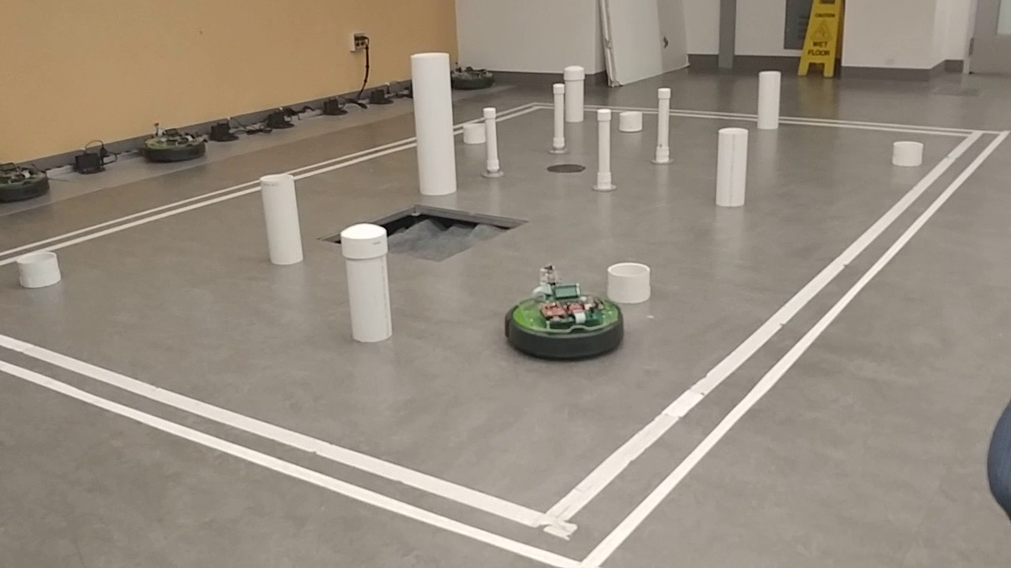
CPRE 288 Overview
What is CPRE 288?
What are we learning
Learning Embedded C programming
Use datasheet to do register level programming of the microcontroller
Write code to control the different devices on the cybot
How do students use this knowledge?
We will make final project to control the Cybot to find the goal
Notes:
Gunny
So, what is CPRE 288?
Cpre 288 is the one of the required course at Iowa State University.
Through this course, students can learn Embedded C programming and Use datasheet to do register level programming of the microcontroller.
Also, students can write code to control the different devices on the cybot.
So, ho do students use this knowledge?
They can use this to do final project to control the cybot to find the goal.

Slide 4
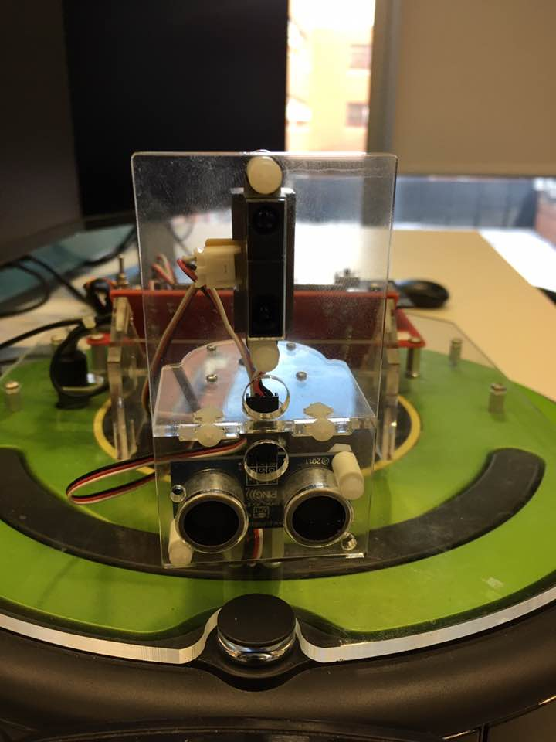
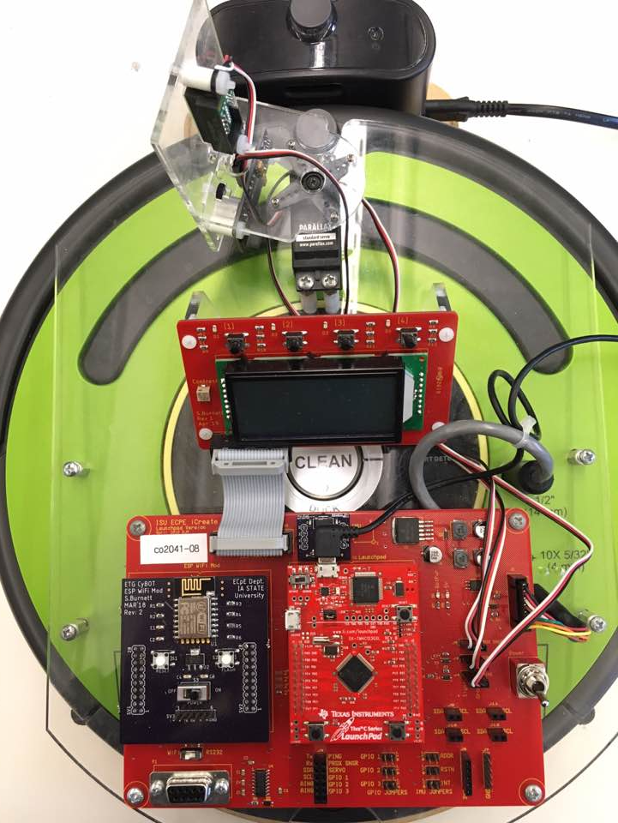
The Cybot Roomba System
1. Servo
7. IR Distance Sensor
2. Buttons
3. Cybot LCD
4. Cybot Baseboard
8.Sonar Distance Sensor
5. Microcontroller
6. Wi-Fi board
Notes:
Gunny
This is the Cybot Roomba System.
As you can see the numbers( 1 to 8) there are 8 things that cybot has it. Which are Servo, Buttons, LCD, baseboard, Microcontroller, Wifi-board, IR Distance Sensor and Sonar Distance Sensor.

Slide 5
Conceptual/Visual Sketch
Automated Unit Tests
For Who?
Professors
TAs
Students
Organized Git Repository
Continuous Integration
Notes:
Sam
Automated: Making a automated unit tests for each device
Git Repo: Creating a new organized git repo for the cpre 288 class
Continuous Integration: Allows us to run tests automatically whenever code is changed on git

Slide 6
Requirements
Functional
Automated unit tests for all currently used code libraries/lab solutions
Connected with Gitlab’s Continuous Integration tools
Simulated hardware(sensors,roomba, etc.) in order to run tests automatically
Git repositories to be used for the CPRE 288 class
One for professors/TAs
One for students
Non-functional
Tests should be easy to run
Code should be well written and easy to understand
Git repositories should be well designed and easy to use
Notes:
nathan slice 6
In order to successfully complete our project we have several requirements that we need to meet. The functional requirements involve creating unit tests for all of the Labs and the parts of the Cybots that are used in each lab, continuous integration which is having the ability to continuously assure tests work when they are added to the simulation environment, we have simulation of external hardware which allows us to run tests and make sure they work properly without need for a physical Cybot, and last we are going to reorganize a git repository for the class to better suit the needs of the clients.
Non functional requirements include being able to run our automatic and manual tests easily, making sure that the tests are easy to understand for those who are running them, and verifying that the tests are reliable and do not fail for problems other than that there is an actual issue with the Cybot. Technical constraints include making the tests correctly work on the Cybots, and allowing them to be modified if the Cybots are altered.

Slide 7
System Design
Notes:
Jacob

Slide 8
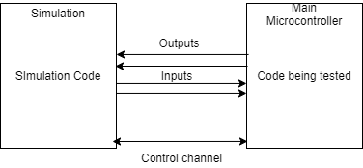
Enabling automated unit tests
Need to be able to change inputs/observe outputs of our functions
difficult to automate when most of our inputs/outputs are coming in and out of the microcontroller
inputs coming from distance sensors
output going to a servo
Solution is instead of using the actual sensors/actuators, use a seperate microcontroller to simulate the inputs/read the outputs
this microcontroller can then be communicated with in order to change inputs/check outputs
Notes:
Jacob
Next we’re gonna talk about our system design
The biggest design problem we had was to be able to allow for actually automating our unit tests. To do that we needed some way to be able to test various inputs and observe the outputs of our various functions and systems. Because most of the inputs are coming from the outside world(for example, the distance sensors), we need a way to automatically change those to be able to test our code. Also many of our outputs are sending signals to the outside world(for example the servo), so we also need a way to observe those outputs.
One way to approach this would be create some machine that can move objects back and forth in front of the distance sensors and maybe a camera to observe the position of the servo, but this idea is sort of impractical.
Another way to do it is to program a full simulation of the entire thing in code. This would make it easy to test, however we would have to create a simulation of the microcontroller itself, which we would never be able to exactly copy.
So our final solution is a mix between those two. We run the code we are trying to test on its actual microcontroller, but we simulate the external hardware(like the sensors and servo) in a separate microcontroller and then wire them together. The idea is that lab code thinks its interacting with the real thing, but it’s actually not.
The simulation microcontroller will be sending out fake signals and taking in whatever the lab code is outputting.
Looking at the diagram here, you can see a small example of how this might work. On the right we have our simulation, and it will be sending signals out of it to mimic the ir distance sensor, which will be picked up by our lab code or tests.
You can also see the arrow for the servo being input directly into the simulation. The simulation board will take the signals meant for the servo and keep track of its current position.
We also have a control channel that can send messages to the the simulation to either query information or change its settings. For example you can ask it what the position the servo is at, or change how far away the distance sensors are from the roomba.
This is just a small example, all the different components you saw on the earlier slide are implemented this way.

Slide 9
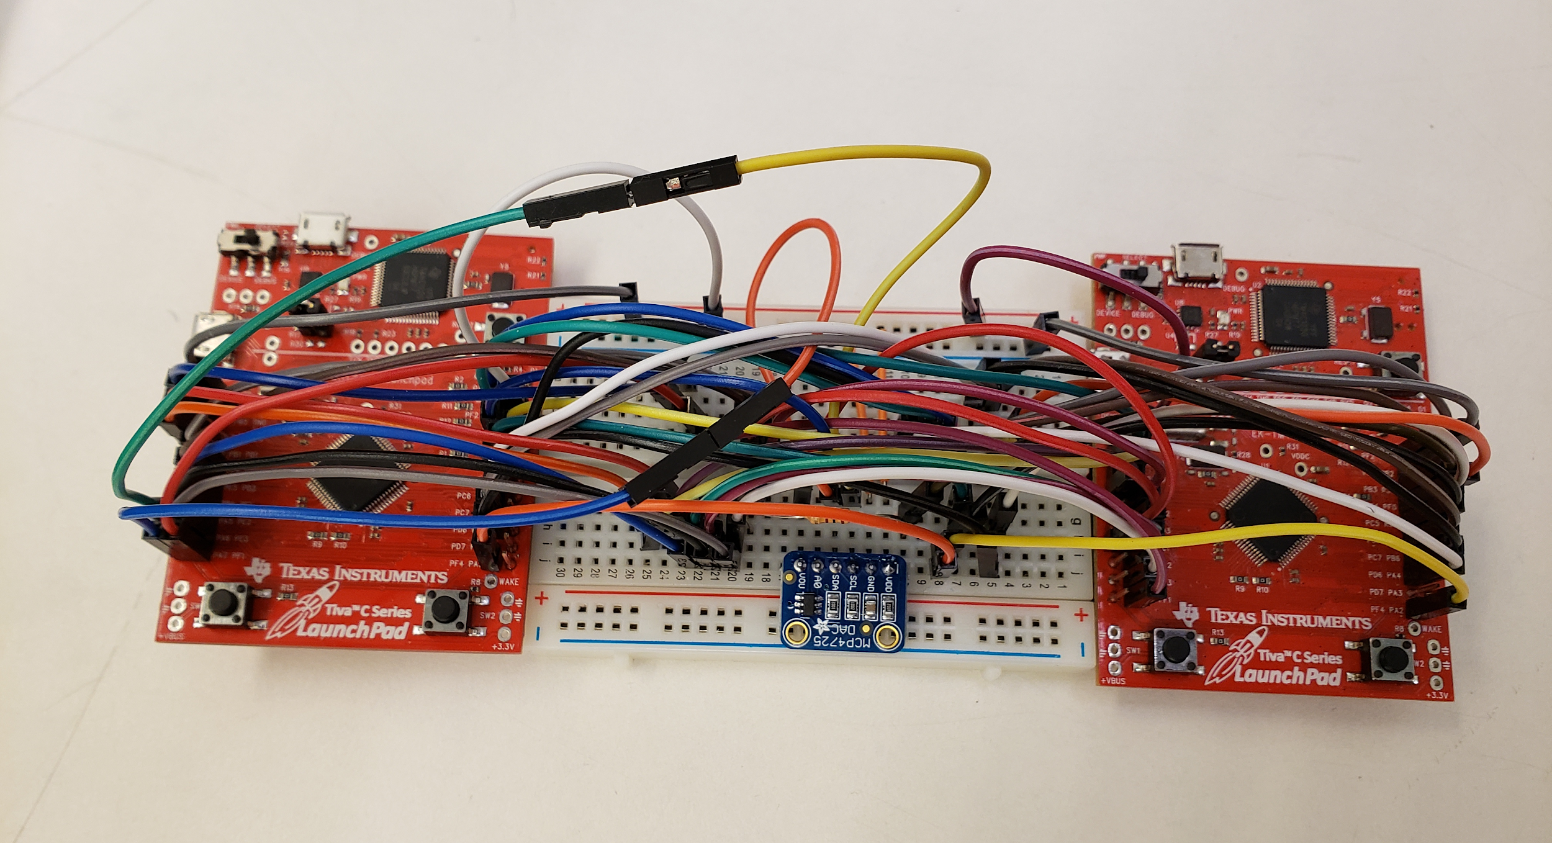
Implementation
Most signals being sent are digital, and pins are directly connected between the microcontrollers
pulses of a certain width
UART communication
Texas Instruments Tiva C series Microcontroller
Simulation
Microcontroller
Main Microcontroller

Slide 10
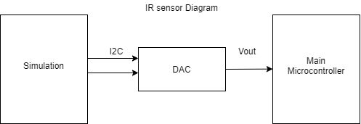
Infrared Distance Sensor
The one exception to to having all digital signals is the IR sensor
The IR sensor outputs an analog voltage
We use a DAC to simulate the IR sensor
Controlled with I2C
Notes:
Sam:
How the IR sensor functions, is that is sends an analog voltage between 0 and 3.3V to indicate the distance. Our microcontroller cannot produce an analog output.So we used a DAC to produce this analog voltage. Basically, this device allows us to produce an analog voltage and later we compare this value with the measured value in one of the microcontrollers.

Slide 11
Changing inputs and Observing Outputs
The simulation provides an API such that the test program can change the state of the simulation or observe the current state
For example:
After attempting to change the servo position, query what position the servo is actually at
Changing the distance an object is away from the distance sensors to test the distance sensors work at various different distances
Implemented as a separate UART connection
packets for each type of command
Notes:
Jacob

Slide 12
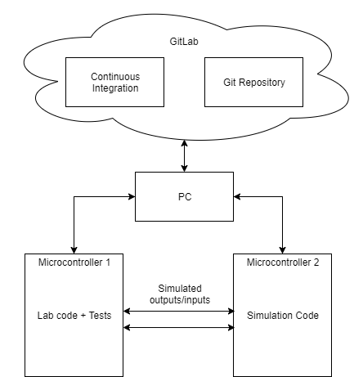
High level design for testing + Continuous Integration
Connect to PC to Git and Simulation platform.
When push the code to the PC to GitLab, then it will automatically runs unit tests on a git commit (push the code)
Notes:
Gunny
This is the picture of high level design for testing and continuous integration.
To do this, we connect the simulation platform to PC and connect PC to Gitlab. When someone push the code to the Pc to GitLab, then it will automatically runs unit test on a git commit(push the code)

Slide 13
Git Repository Organization
Why Reorganization?
Creating new repository for the 288 class.
Current git repository contains lot of unneeded folders and files.
Students need access to some files, but need to be restricted from viewing others.
Creating two repositories (1 for Professor+TA(private), 1 for student(public))
All files will be located in the Professor+TA repo
Files meant for students will be into the student repo
Notes:
Jisoo
To manage the files related to course, we decided to use git repository. Current course repository has lot of unneeded folders and files, so it needed to reorganized.we created new repositories to push the our works, documents, lab stuffs. however, some files need to be restricted by students. that is why we are using two separate repositories. one repository for professors and TAs only, and this will be private to restrict the access from student. this repository will contains answers for labs. the other repository will be for student and this is public repository. this contains all files and documents for labs excluding answers. by having two repositories, we can manage the files efficiently in different level of access permission.

Slide 14
Milestones

Slide 15
Unit Testing Milestones
Complete :
Sonar sensor
Servo
Buttons
Timer.c helper file
contains wait functions(i.e. wait for 100ms)
Roomba
Open Interface
gives us access to the various sensors on the Roomba
Driving
LCD
UART
IR Sensor
Notes:
Nathan
We have created unit tests for the sonar sensor, Servo, Buttons, timer.c helper file, the roomba’s open interface and its driving, the lcd, uart, and ir sensors.

Slide 16
Continuous Integration Milestones
Complete
Automatic loading and running of code on microcontroller
Automatically triggering tests on a git commit
Show the test results(either pass or fail)
Notes:
Gunny
We finished
Automatic loading and running of code on microcontroller
Automatically triggering tests on a git commit
Show test results(either pass or fail) to Gitlab

Slide 17
Testing

Slide 18
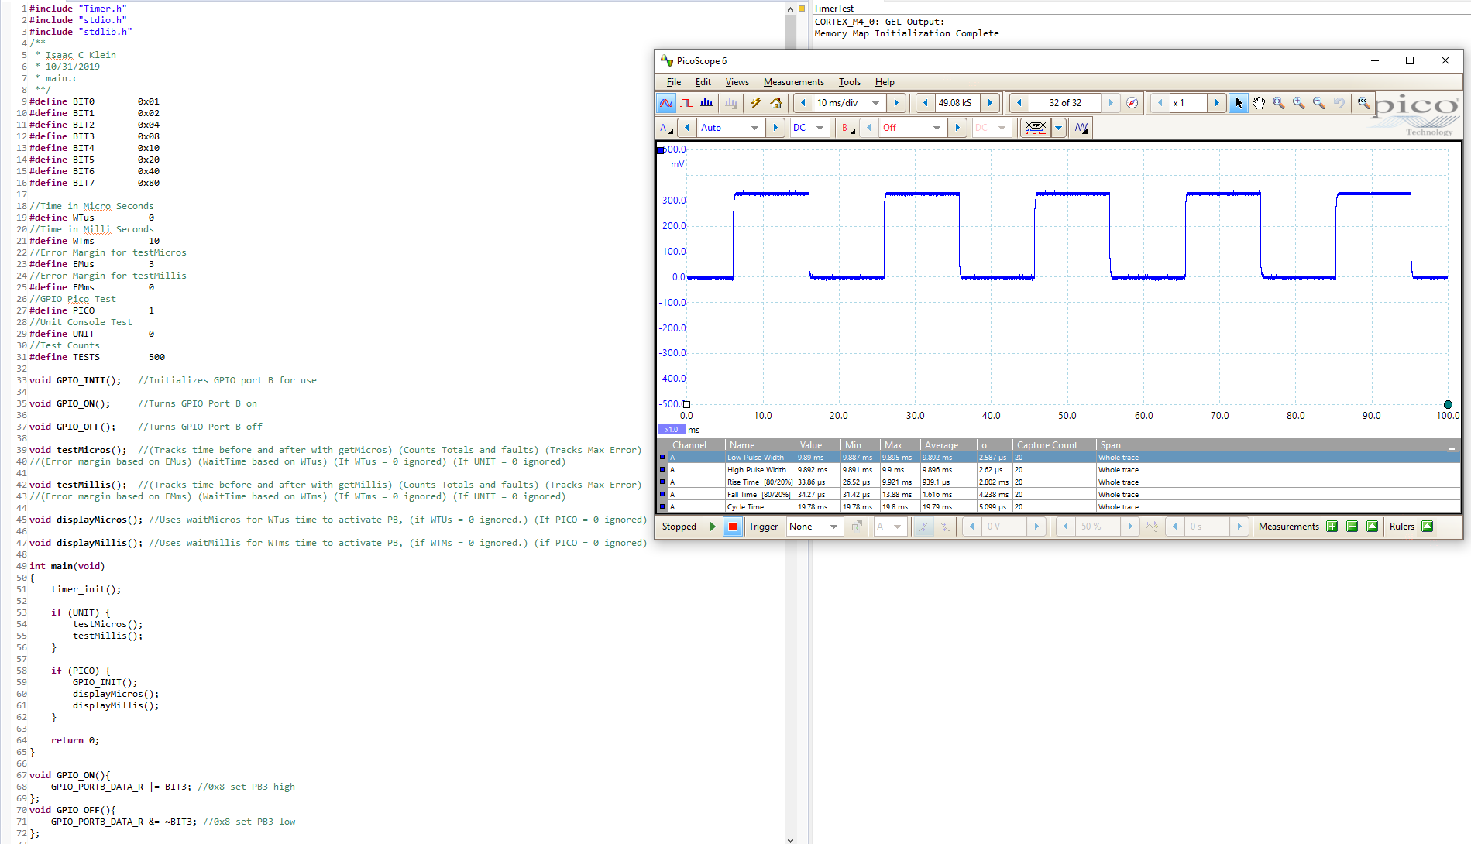
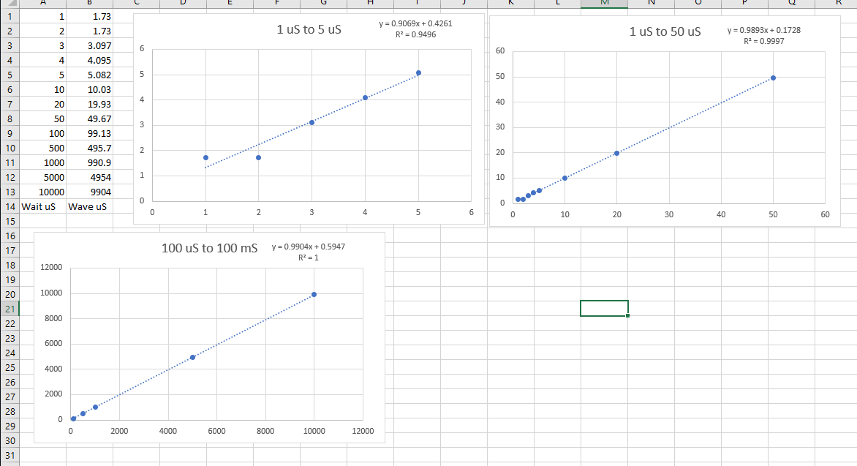
Manual Testing
Timer testing
WiFi testing
Manual testing is also
important because of
variances between software and
hardware accuracies.
Notes:
Isaac, Nathan
Manual testing is also important to gauge the variances and accuracies of the software and hardware devices. For example in the case of the timer which has a function to wait anything greater than 2 microseconds, has a slight deviance of accuracy. If you used the system clock to see how accurate the timer is it would tell you you waited slightly more micro seconds then in actual which increases the longer time you wait. However from an oscilloscope reading which tests the clocking at high accuracy in real time, it will tell you that it didn't wait quite enough by microseconds or more.
Wifi testing was important because of reports of packet loss between users laptops and a rhomba. After many combinations of ascii keys to send to the device all packets sent were received. The only varying issue was if two keys were send too quickly, they may have been received by the device in the opposite order making what appears as packet loss. Uart testing is similar but using a wire and is found to be very fast and accurate.
IR is known to be fairly accurate for detecting objects location in radians, but is less accurate in detecting an object's distance. Which is why a separate lab for students utilize a sonar to find the distance of a device. Because of this the standard function to find distance of an object with IR has variation by each rhomba device and needed manual testing by device to make sure they were workable.

Slide 19
System Level/Unit Testing
Tests implemented as C code running on the microcontroller
No specific testing framework
System level tests
Tests to verify one use case for a device
For example: Getting the distance from the sonar sensor
Unit tests
Testing all of the individual parts of a system
For example: testing each step that occurs when getting the distance from a sonar sensor.
Notes:
Isaac
We are making sure write tests for all of our code. All tests are just written in C code running on the microcontroller. We don't use any specific framework. We have systems level tests to make sure the high level use cases are all met and also smaller unit tests for each small part of functionality

Slide 20
Engineering Standards and Design Practices
Agile software development
Unit testing
Continuous integration
Notes:
Jisoo
For Engineering Standards and Design Practices, First, we used the Agile software development because we can feedback from the client and, based on the feedback, we can add more stuff to achieve our goals. To do unit testing, we can check and find the errors that we had in CPRE 288 labs. For the continuous integration, we can check the code automatically when someone push the code at the git repository.

Slide 21
Automating the running of tests
Debug Server Scripting(DSS)
Allows us to control our IDE’s debugger from a script
Lets us build our project and run it on the microcontroller automatically
Continuous Integration
Automatically runs unit tests on a git commit
Communicates with a PC connected to the simulation platform and runs DSS script
Test results will be reported back to Gitlab
Used Python script to show the pass or failed
Notes:
Gunny
Debug Server Scripting (DSS)
It allow us to control out IDE’s debugger from a script. It allow us to build our project and run it on the microcontroller automatically.
Continuous Integration
Gitlab includes built-in Continuous Integration tools that allow us to automatically run our tests on a commit.
It also displays the results of the different stages of the CI pipeline (Build and Test).
It communicate with a PC connected to the simulation platform and runs DSS script. The test result will be reported back to Gitlab.
We used Python script to check whether the test result is pass or failed.

Slide 22
Conclusions
Project Progress :
Unit testing
Establish the simulation platform
Implementation
Creating git repository
Manual testing
Automated testing
Continuous integration
Individual team members contributions :
Jacob Aspinall - Simulation Platform
Geonhee Cho - Continuous Integration / Code review & Demo Videos
Jisoo Han - Git repository
Nathan Nordling - UART testing/Git repository
Sam Rai - IR Sensor Testing
Isaac Klein - Manual testing
Notes:
jisoo
During the course, we have done working on stuffs (first line). This is what we contributed on. ( list name and work)

Slide 23
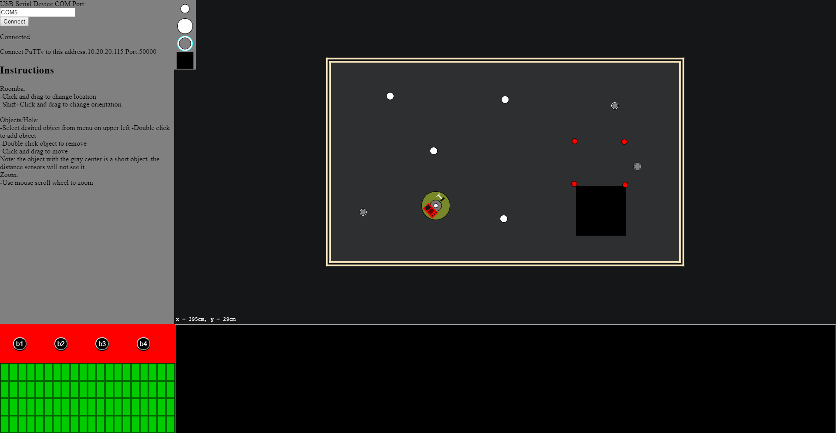
Bonus: Turning CPRE 288 into an online course
Due to COVID-19, 288 will be an online class during the summer.
We are currently working on attaching a GUI to the simulation, allowing students to do the class remotely.
Notes:
Jacob
As a bonus, due to the coronavirus situation, 288 would have to be offered online during the summer. So about a month ago we were tasked with seeing if we could attach a GUI to the simulation platform we made so students could actually do the class remotely. So you can see we turned what is on the left picture here, to what’s on the right. It's currently still a work in progress, but the idea is that students would remote into a lab computer connected to one of the simulation boards, and do all the labs from the comfort of their own home.

Slide 24
Q & A

Slide 25
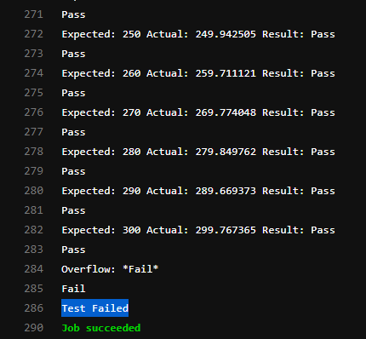
Appendix 1: Test Output
when test passed, it showed the
when test failed it showed failed
Notes:
Right picture showed the test passed when it passed all tests.
Left picture showed the test failed when one result failed. It showed where is failed.

Slide 26
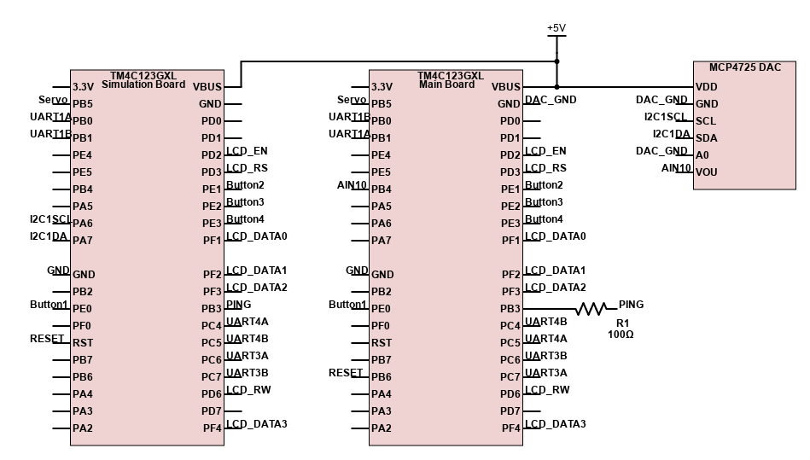
Appendix 2: Circuit Schematic

